Slide 1
INFERENTIAL STATISTICS

Slide 2
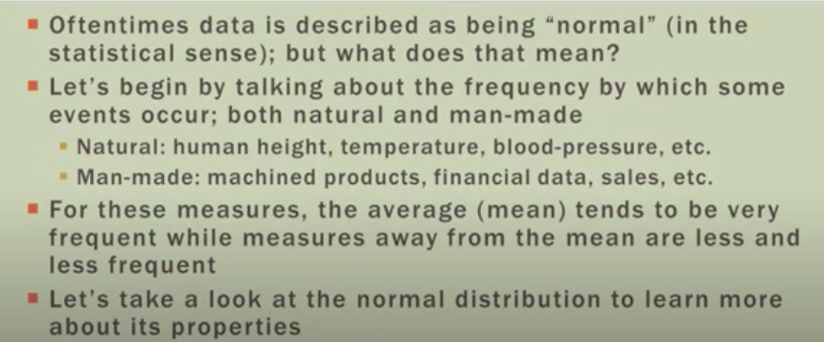
Introduction to Normal Distribution

Slide 3
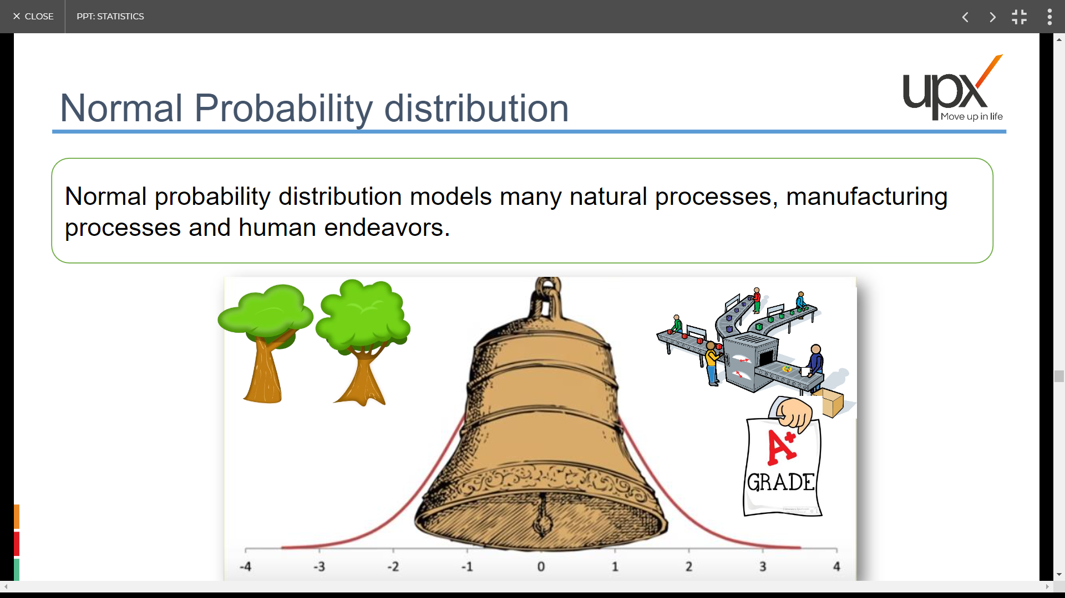
Normal Probability Distribution

Slide 4
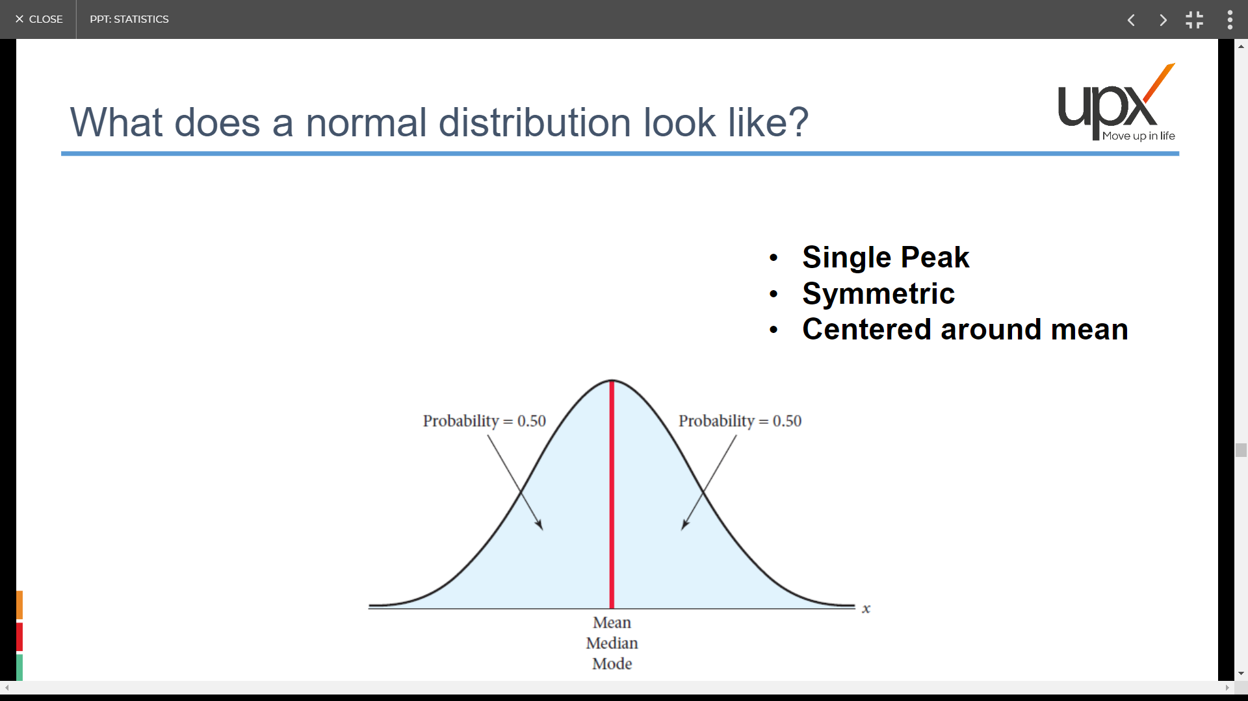
Properties of Normal Distribution
Lower Tail
Upper Tail
Underneath the curve we have probability Area=1
Mean , median or mode are the same
The shape is determined by std (details in next slide)

Slide 5
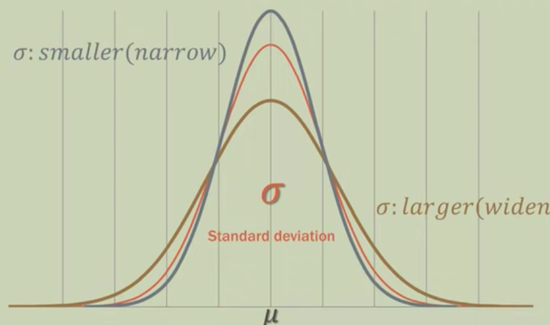
Shape determination of Normal Distribution
If std is small the curve is narrow and tall
If the std is large, the curve is wide and short

Slide 6
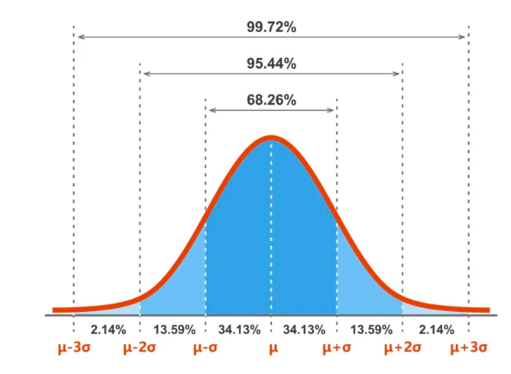

Empirical Rule of Normal Distribution
The empirical rule, also known as the three-sigma rule or the 68-95-99.7 rule, is a statistical rule that states that almost all observed data for a normal distribution will fall within 3 std deviations (denoted by σ) of the mean or average (denoted by µ)

Slide 7
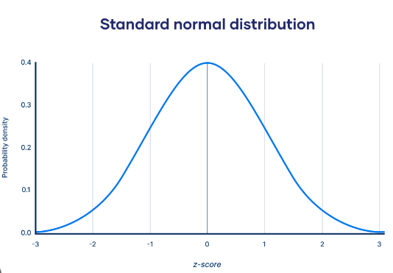

Standard Normal Distribution (Z Distribution)
A special normal distribution with Mean =0 and std =1
BUTTTTT!!! Why do we need SND???
In order to understand, Let’s understand Z table first

Slide 8
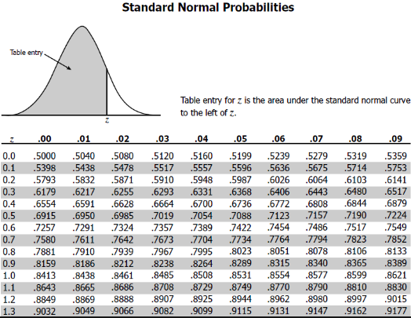
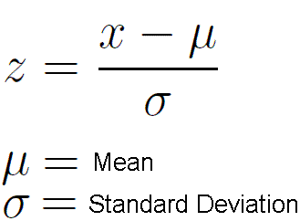
Understanding Z Table
This Z table gives the area on the left for corresponding Z value
When we say Z=1, the area on the left from the graph can be determined as 0.8413
Can you confirm the same from the empirical rule?
To Answer the Question : why do we need SND
We have direct Probability values for corresponding Z value through Z table for SND
So, if we can convert any number from a normal distribution to its corresponding Z value or Z-score (as it is practically not possible to maintain multiple normal distribution table with different mean and std) we can have the probability value easily from the table without any major calculation.
The process of converting any random value x which belongs to a normal distribution to its corresponding Z value is done using the formula

Slide 9




Slide 10

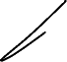

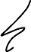
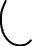
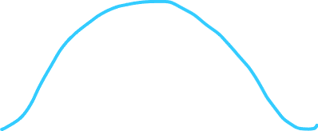
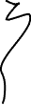

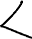

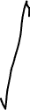
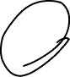
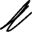

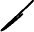
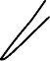

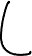
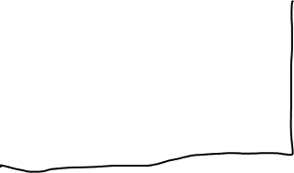
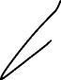
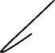
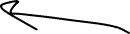

Slide 11
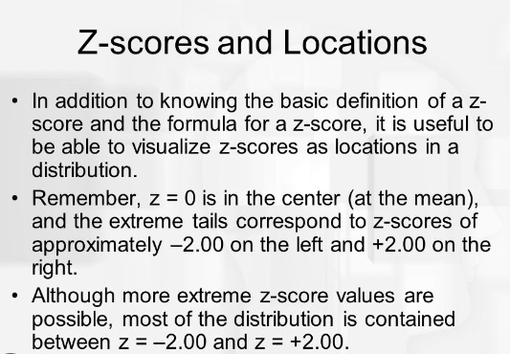
Few Insights about Z score

Slide 12
Let’s solve few numerical
Q1: The math exam, the score of a class is normally distributed with mean = 65 and std=9
a. Find the probability of getting score (x) < 54
b. What is the probability that x is at least 80?
c. What is the probability of getting a score b/w 70 and 86?

Slide 13
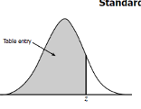
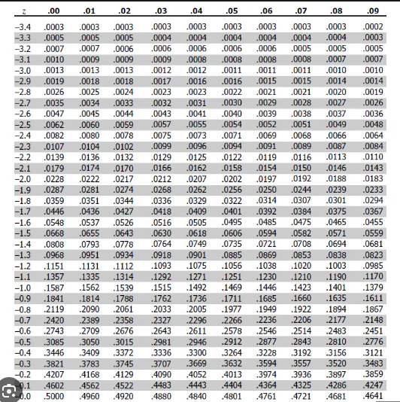
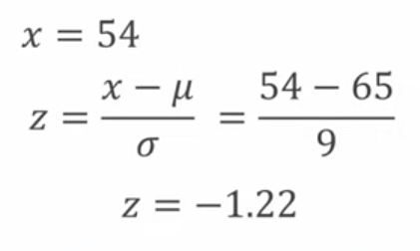
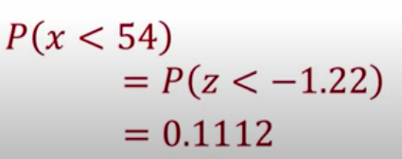
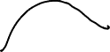
Answer (a)
a.
Find the probability of getting score (x) < 54
So, the probability of getting score < 54 is 11%

Slide 14
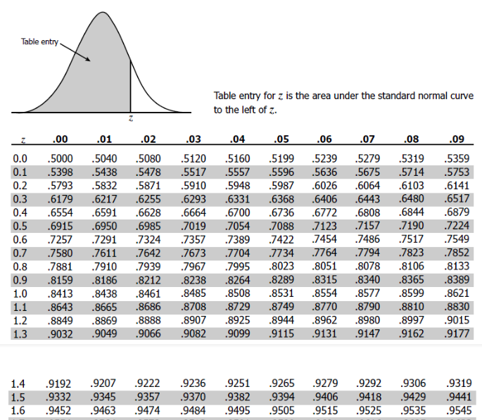
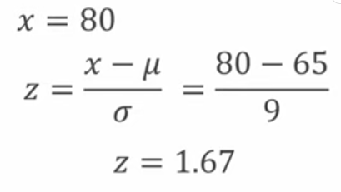
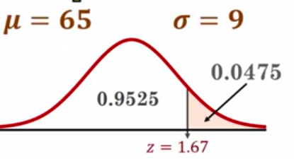
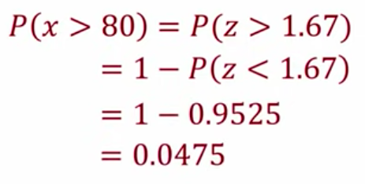
Answer (b)
b. What is the probability that x is at least 80?
So, here we need to find P(x>=80)
So, the probability is 4.75%

Slide 15
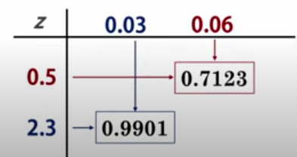
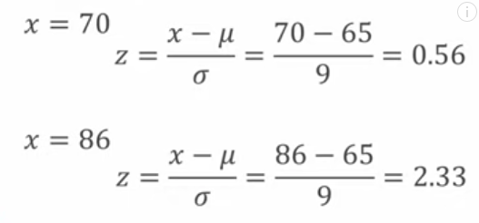
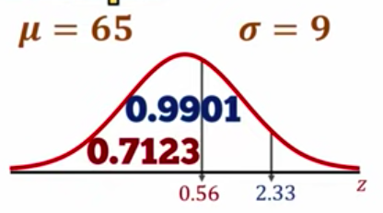
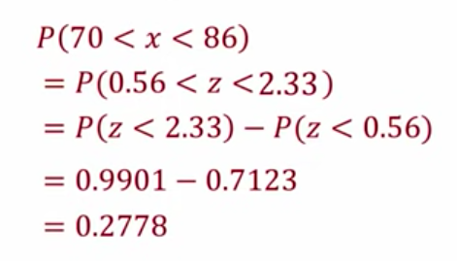
Z table (Area on the left)
Answer (C)
c. What is the probability of getting a score b/w 70 and 86?
So, the probability is 27.78%

Slide 16
Question
Assume the height of female at a specific location is normally distributed with mean 162.2cm and std 6.8 cm. What is the probability of a randomly selected female is taller than 170.5 cm?

Slide 17
Answer
Q: Assume the height of female at a specific location is normally distributed with mean 162.2cm and std 6.8 cm. What is the probability of a randomly selected female is taller than 170.5 cm?
So, I would like to find P(x>170.5cm)
Z = (170.5-162.2)/6.8
=1.22
Let’s first find out the female shorter than 170.5 cm i.e; P(Z<=1.22)=0.888
So, P(Z>1.22)=1-0.88=0.12
So, the prob of selecting a random female taller than 170.5 cm is 12%

Slide 18
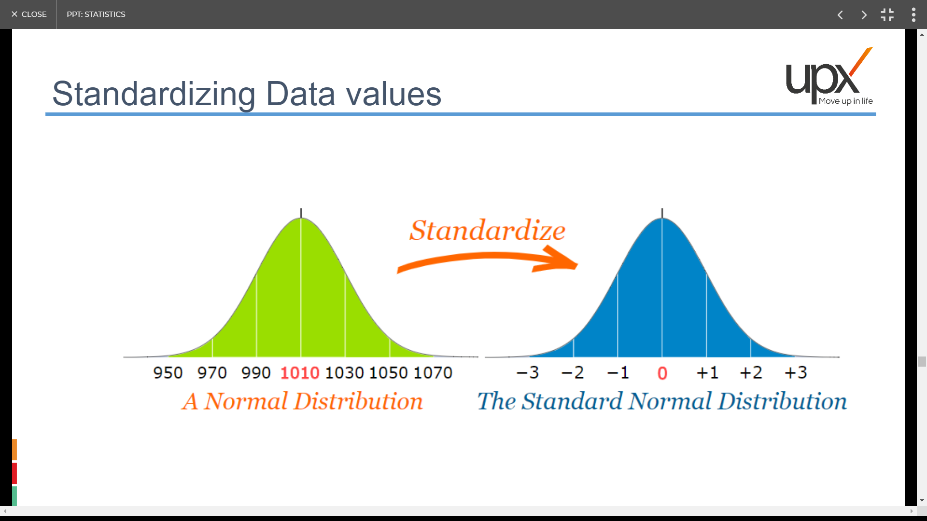
Standardizing a Normal Distribution Data Values

Slide 19
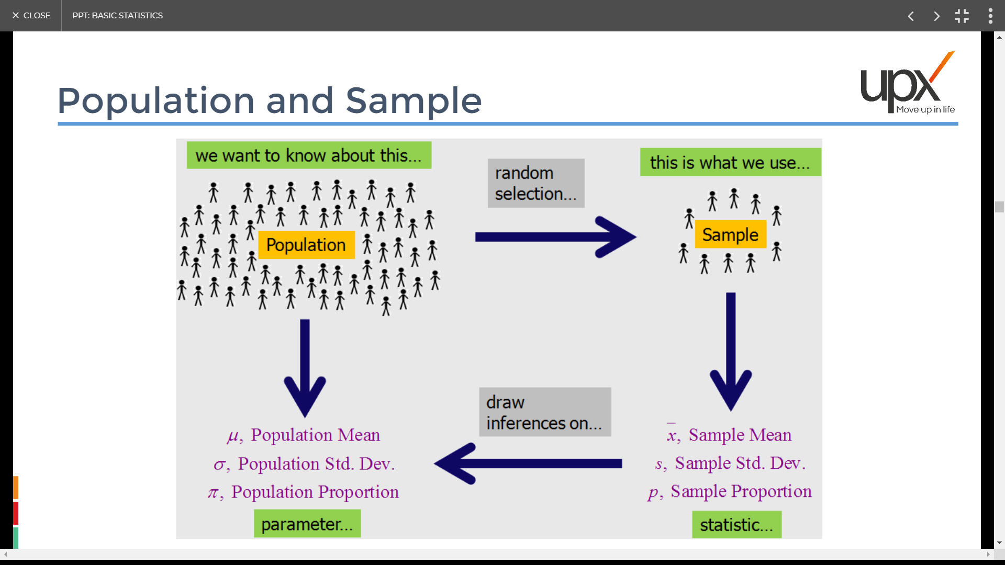
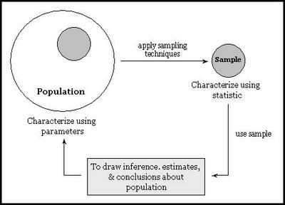
Population & Sample
We try to estimate or infer the parameter value of the population through samples.
This inference can be given with exact value or with some range.

Slide 20
Margin of Error and the Interval Estimate
A point estimator cannot be expected to provide the
exact value of the population parameter.
An interval estimate can be computed by adding and
subtracting a margin of error to the point estimate.
Point Estimate +/− Margin of Error
The purpose of an interval estimate is to provide
information about how close the point estimate is to
the value of the parameter.
Notes:
20

Slide 21
Margin of Error and the Interval Estimate
The general form of an interval estimate of a
population mean is
Notes:
21

Slide 22
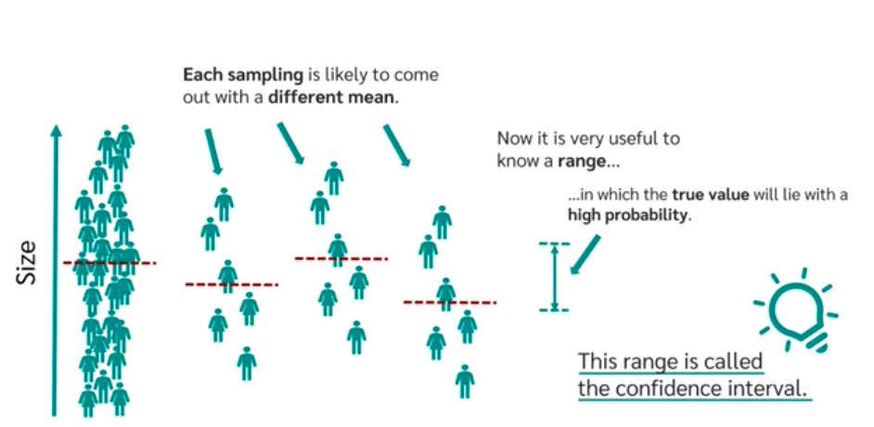
Confidence Interval
As described earlier, we try to estimate or infer the parameter value of the population through samples.
Assume, We want to infer the population height from 3 different samples as shown below.
This is the range in which the true value of population height lies
Sample 2
Sample 3
But how confident are we that the population mean will fall in the same range?
Population
Sample 1

Slide 23
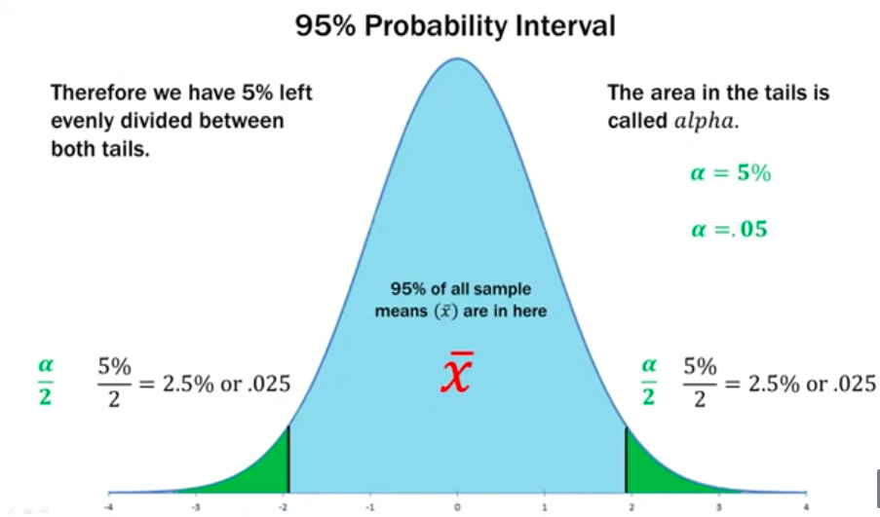
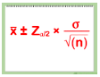
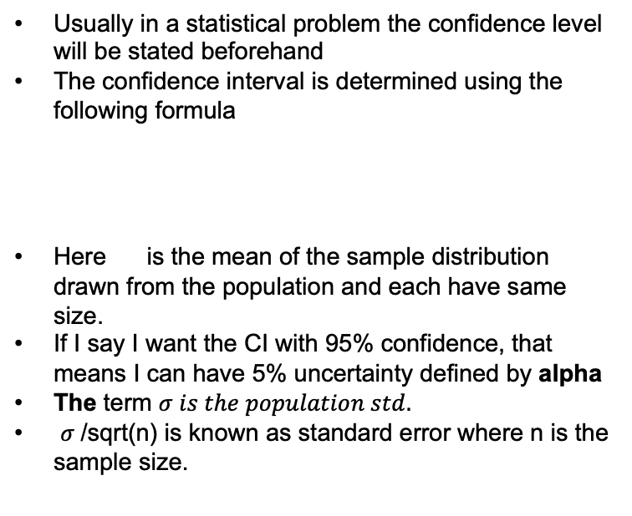
Population & Sample
When we say we are 95% confidence that the population parameter (Mean or std or any value of population) will be within a range, we basically mean that if we take 100 samples of same size and infer the population parameter from them, 95 of the samples will give the parameter that falls with in the CI range, given all the samples are of same size.
Usually in a statistical problem the confidence level will be stated beforehand
The confidence interval is determined using the following formula
Here is the mean of the sample distribution drawn from the population and each have same size.
If I say I want the CI with 95% confidence, that means I can have 5% uncertainty defined by alpha
The term $σ is the population std.$
$σ$/sqrt(n) is known as standard error where n is the sample size.

Slide 24
Intuition on Confidence interval
What happens if I keep increasing the level of confidence in a statistical analysis to infer the parameter value from the samples?
What will be the effect of sample size on standard error?

Slide 25
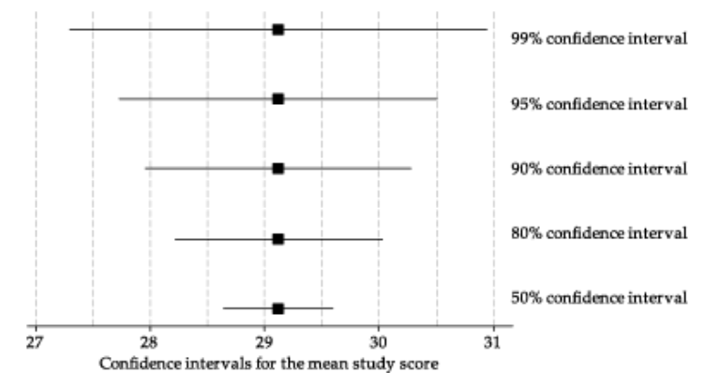
Intuition on Confidence interval
1.What happens if I keep increasing the level of confidence in a statistical analysis to infer the parameter value from the samples?
Let’s Visualize:
So, when we increase confidence level, less chances of error but inaccurate because of high range
When we decrease the level of confidence we make the CI range narrower but more chances of error
Then what is the optimal range?
Usually in the field of statistics 95% CI is the mostly accepted one
What is the Z value when we talk about 95% confidence interval?
Notes:
Note: Draw the picture of different CI %

Slide 26
Intuition on Confidence interval
What will be the effect of sample size on standard error?

Slide 27
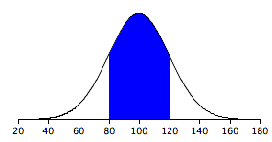
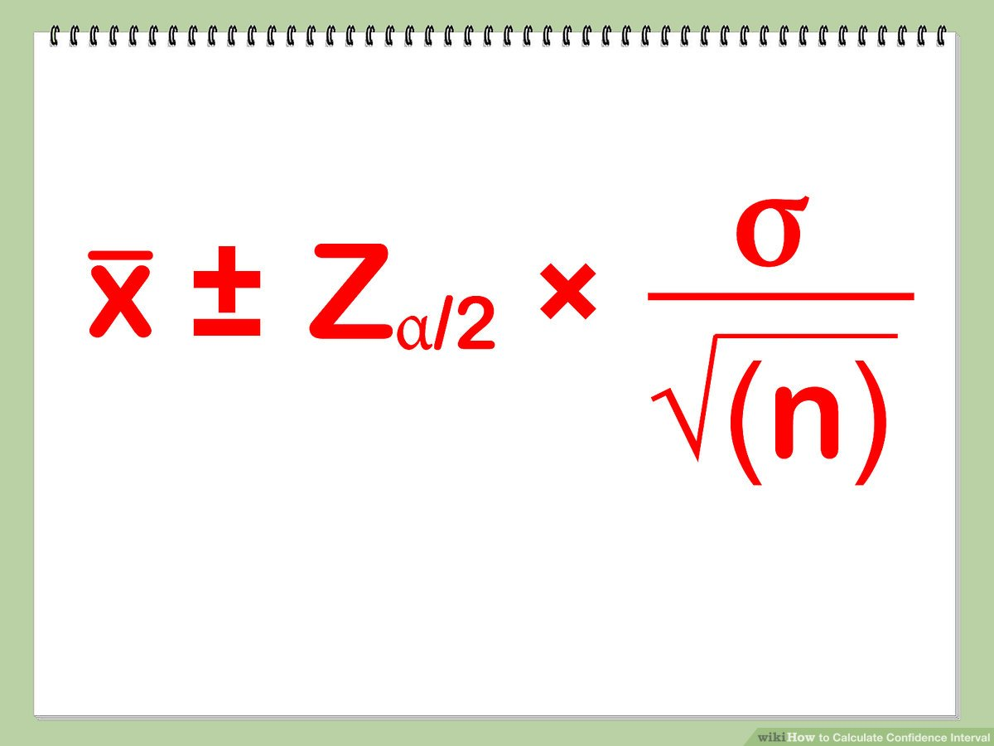
Population & Sample
Mean: 100
SD=1
Sample means of 4 samples
Mean: 100.5
102,101,99,100
CI=
CI= 100.5 +1
-

Slide 28
Interval Estimation
Population std: σ Known
Population std: σ Unknown
Determining the Sample Size
Population Proportion

Slide 29
Interval Estimate of a Population Mean: σ Known
In order to develop an interval estimate of a population mean, the margin of error must be computed using either:
the population standard deviation σ , or
the sample standard deviation s
σ is rarely known exactly, but often a good estimate can be obtained based on historical data or other information.
We refer to such cases as the σ known case.
Notes:
29

Slide 30
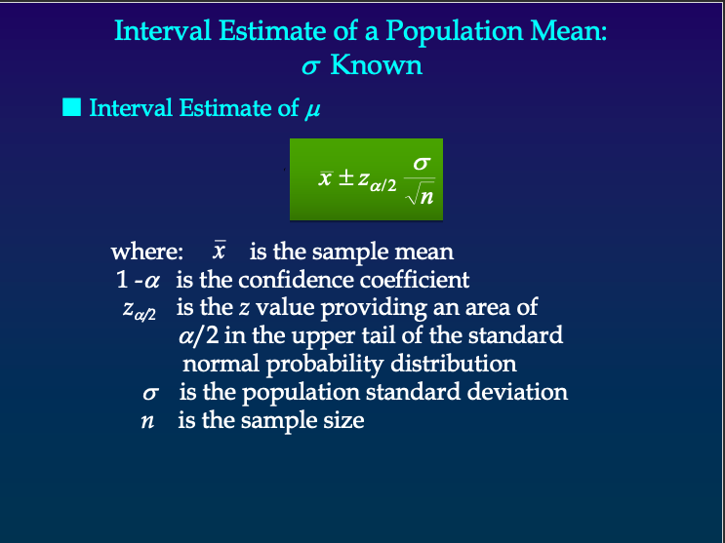

Slide 31
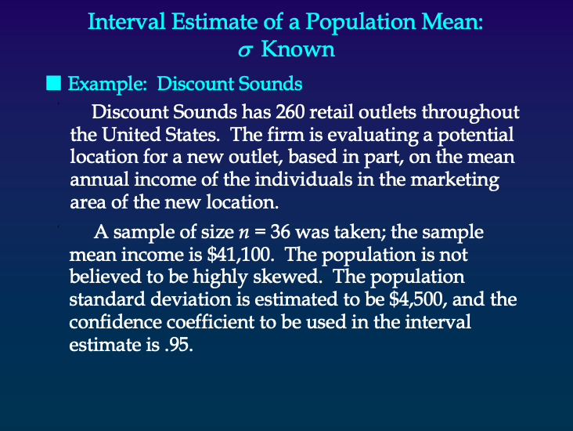

Slide 32


Slide 33


Slide 34

To estimate population parameter, if sample size <30 we use T-distribution
When Sample size is >=30 we use Z distribution to estimate population parameter

Slide 35


Slide 36
















Slide 37



Why do we prefer using T distribution when population std unknown (sample is small)
So here we are estimating S as well as mean.
If we keep using Z distribution, It does not give
accurate result
Using Z distribution in these situations makes the CI narrower so the 95 % CI does not actually cover 95% confidence
Through multiple experiments, William Gosset has proved when population std is unknown and sample size is small then using t-distribution solves the problem.

Slide 38








Sample is small
Population std is 3.8 where as sample std is 1.73
Std got affected badly by reduced size of sample
Small std will further reduce the standard error which will reduce the range of confidence interval

Slide 39










Sample is high
Population std is 3.8 where as sample std is 4.08 which is quite close
So, when sample size is large, we don’t need to nullify the problem of std which caused reduction of the confidence interval range. Therefor for these situations we can use Z distribution

Slide 40














Slide 41

T Distribution (before we jump to population Std unknown)

Slide 42



T Vs Z distribution

Slide 43


Slide 44


Slide 45


Slide 46


Slide 47


Slide 48

Central Limit Theorem

Slide 49

Central Limit Theorem

Slide 50














Slide 51






















Slide 52

Central Limit Theorem
So, if more number of samples, narrower the curve

Slide 53


Z score/ Standard Score
Perfume bottles are filled with an average volume of 150cc and a standard deviation of 2cc.
What percent of bottles will have a volume of more than 153 CC?
=150 cc
Z = 1.5
=2 cc

Slide 54













Standard Error Vs Standard Deviation
If we take multiple samples from a population of n size and plot their mean then the std deviation of that distribution is known as std error
Why?
Because, the std of the distribution will decide how
erroneous/ big range the of the margin of error.
If you increase the sample size, it is more probable that there are less error in the prediction of population mean

